Slide 1


GameZone: Game, Win, Rule!
Welcome to GameZone, where entertainment meets opportunity! Dive into a world of free and paid games designed to thrill and reward. Start your journey now and climb the leaderboard!

Slide 2
Unleash the Fun: Free Games Showcase
Tic-Tac-Toe
Snake
Brick Game
A classic game of strategy and wits. Challenge friends or play solo.
Navigate the snake, eat, grow, and avoid obstacles. Simple yet addictive!
Break bricks and collect power-ups. A retro arcade experience.

Slide 3

Challenge Accepted: Paid Games for Big Rewards
1
Mine Game
Test your luck and strategy. Uncover hidden treasures while avoiding mines. Earn coins for every safe move!
2
Color Trending
Predict color trends and multiply your coins. The more accurate your prediction, the bigger the reward!

Slide 4
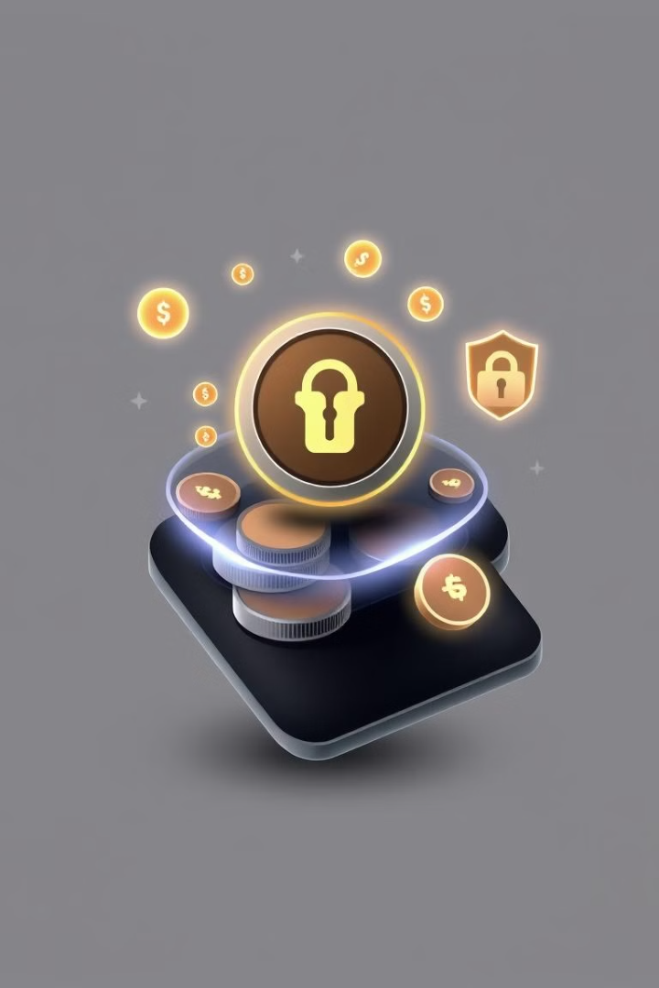



Your GameZone Wallet: Earn, Withdraw, Repeat!
Earn Coins
Secure Wallet
Easy Withdrawals
Win coins by playing free games and paid challenges.
Store your coins securely in your GameZone wallet.
Withdraw your earnings with seamless transactions.

Slide 5
GameZone: Merits & Demerits
✅ Merits (Advantages)
❌ Demerits (Disadvantages)
Engaging Gameplay – Multiple games to keep users entertained.
Requires Internet – Online connectivity needed.
Paid Games Require Coins – Users must earn or deposit coins.
Earning Potential – Win coins and withdraw them securely.
Limited Games (For Now) – Expansion needed for variety.
User-Friendly Interface – Easy navigation and smooth gameplay.

Slide 6





Future Enhancements: Elevating Your Experience
Multiplayer Mode
Compete with friends in real-time.
Daily Rewards & Bonuses
Get extra coins for daily logins.
More Games
Expanding the game collection.
Mobile App
Dedicated app for seamless gaming.

Slide 7
THANK YOU

